Slide 1
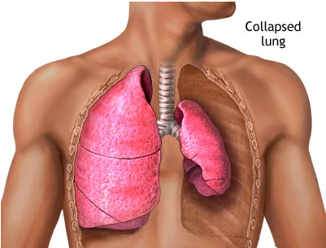
1.7 Accident Management (Chest Trauma)
SK-DIV-PPT-005
PNEUMOTHORAX
Air or gas in the plural cavity as a result from injury to the lung can lead to a collapsed lung
SIGNS AND SYMPTOMS
SOB or fast shallow breathing
Dry cough
Cyanosis
Hunched over-favouring one side
Pain on inspiration
Pale/clammy skin
Tachycardia
Movement of trachea away from affected side
Distended neck veins
TREATMENT
Immediately cover sucking chest wound on 3 sides if present.
Analgesia NSAID’s(Non-streroidal Anti-Inflammatory Drugs (not narcotics))
Send for help, monitor ABC and put in recovery position injured side down
Thoracostomy

Slide 2
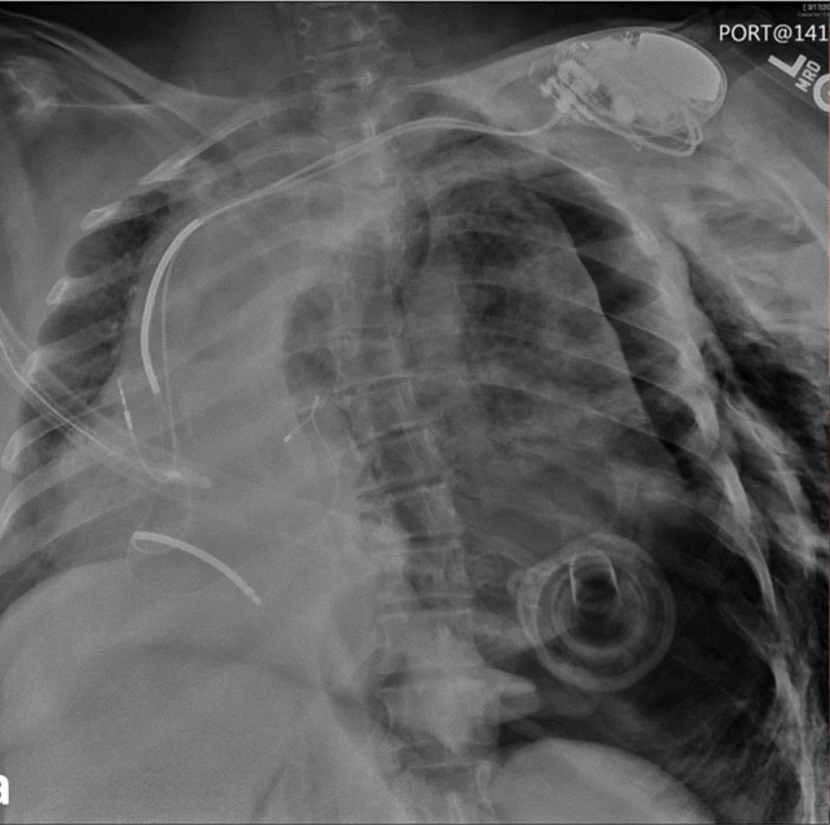
1.7 Accident Management (Chest Trauma)
SK-DIV-PPT-005
TENSION PNEUMOTHORAX
Air in the pleural space causing increased intra thoracic pressure mediastinum shift which obstructs the superior and inferior vena cava putting pressure on the other organs and heart and decreases cardiac output – leading to cardiac arrest.
SIGNS AND SYMPTOMS
Decreased breathing sounds
Tracheal deviation
Chest will rise unevenly
Fast pulse
Low Blood pressure
Pale, cool and clammy skin
Surgical emphysema (air trapped under the skin, sounds crackly when you touch it)
TREATMENT
Analgesia NSAID’s(Nonsteroidals Anti-Inflammatory Drugs (not narcotics))
Oxygen
Thoracostomy

Slide 3
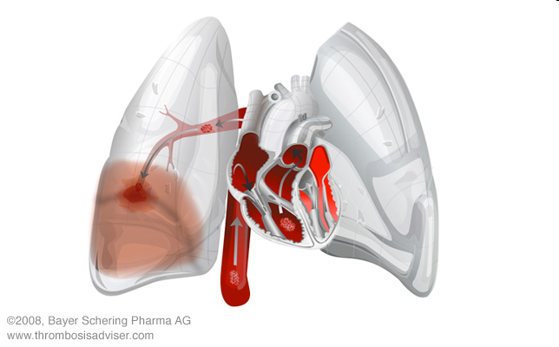
1.7 Accident Management (Chest Trauma)
SK-DIV-PPT-005
PULMONARY EMBOLISM
Blockage of the main artery of the lung or one of its branches by an embolism such as air, fat or blood clot (usually DVT). It obstructs blood flow through the lungs putting pressure on the heart.
SIGNS AND SYMPTOMS
Chest pain, often sharp and felt when you breathe deeply
SOB
Fainting if heart rate or blood pressure drops
Cough, may include bloody or blood-streaked mucus
Rapid or irregular heartbeat
Lightheadedness or dizziness
Excessive sweating
Fever
Leg pain or swelling, or both
Clammy or discolored skin, called cyanosis
TREATMENT
Anti-coagulant therapy
Thrombolytic therapy
Surgery

Slide 4
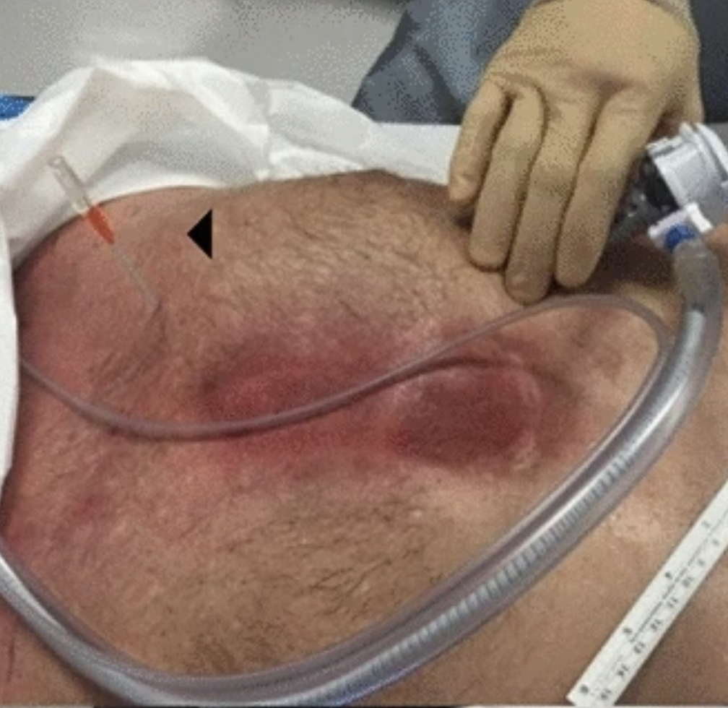
1.7 Accident Management (Chest Trauma)
SK-DIV-PPT-005
HAEMOTHORAX
The accumulation of blood within the pleural space, the cavity between the lungs and the chest wall. It is a potential life- threatening condition
SIGNS AND SYMPTOMS
Chest pain, often sharp and stabbing
SOB
Cough
Compromises circulation and reduces ventilation
TREATMENT
Analgesia NSAID’s(Non-steroidal Anti-Inflammatory Drugs (not narcotics))
Oxygen
Thoracostomy

Slide 5
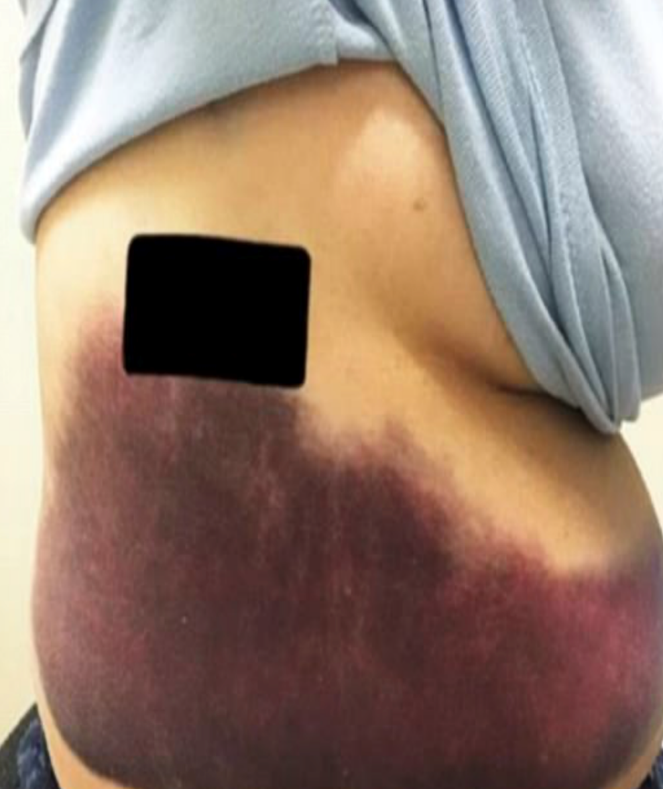
1.7 Accident Management (Chest Trauma)
SK-DIV-PPT-005
RIB FRACTURES
1st rib is rare to break as it is protected by the clavicle. If it is broken it can cause serious damage to the brachial plexus ( a group of nerves that run from the neck to the axilla) and can impair function and movement.
1st and 2nd ribs associated with head and facial trauma.
Middle ribs are most commonly fractured from direct blows or indirect crush injuries
Most commonly fractured are the 7^{th –} 10th rib
Fractured ribs are really painful because ribs have to allow for breathing and even a small crack can inflame the tendons and cripple an arm.

Slide 6
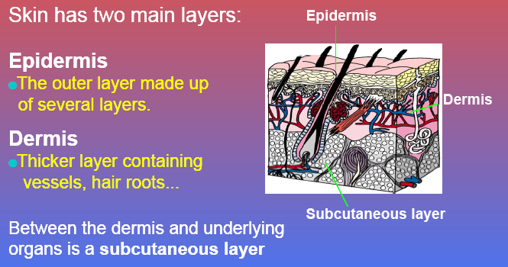
1.8 Accident Management (Burns)
SK-DIV-PPT-005
The skin has two main layers
EPIDERMIS
The outer layer made up of several layers
DERMIS
Thick layer containing vessels, haor roots….
Between the dermis and underlying organs is a subcutaneous layer

Slide 7
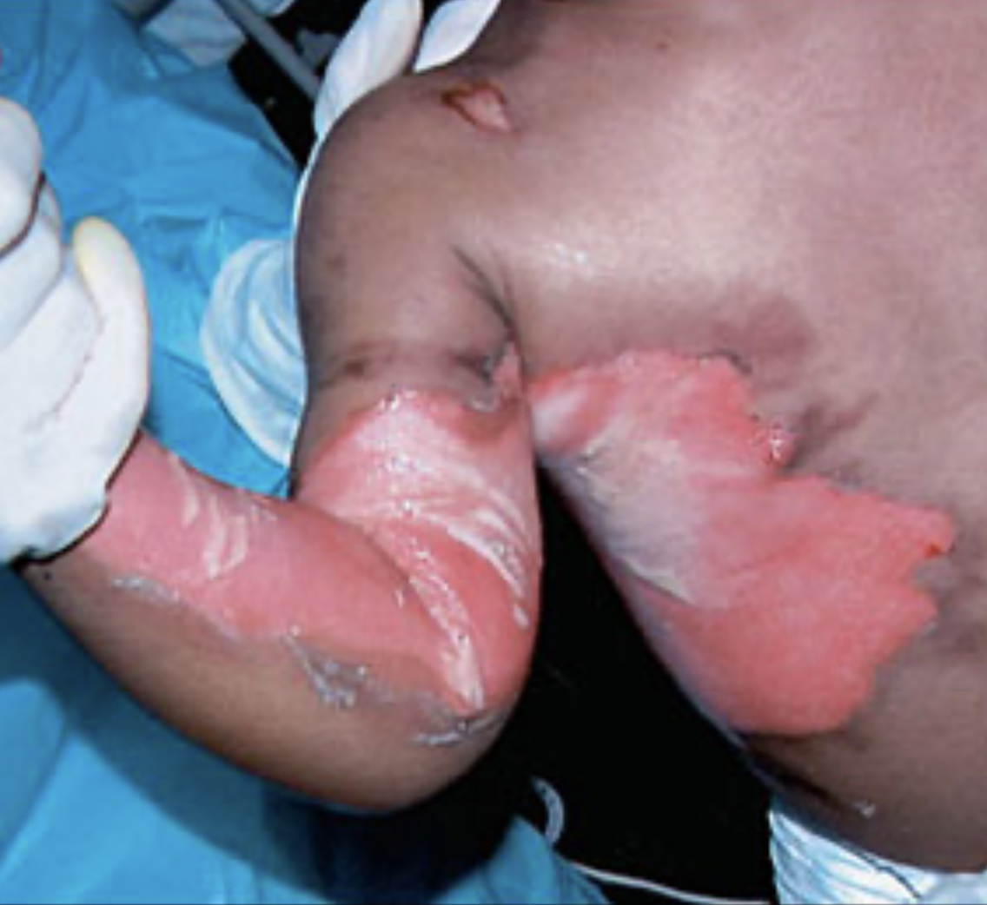
1.8 Accident Management (Burns)
SK-DIV-PPT-005
TYPES OF BURNS
Superficial
involves epidermis- redness and pain (e.g, sun burn)
Partial thickness
Involves epidermis and part of the dermis-severe pain, redness, blistering of burn, weeping from burn.
Full thickness
Epidermis and dermis layers damaged and subcutaneous may also be damaged- painless, white or charred, cracked and dry.

Slide 8
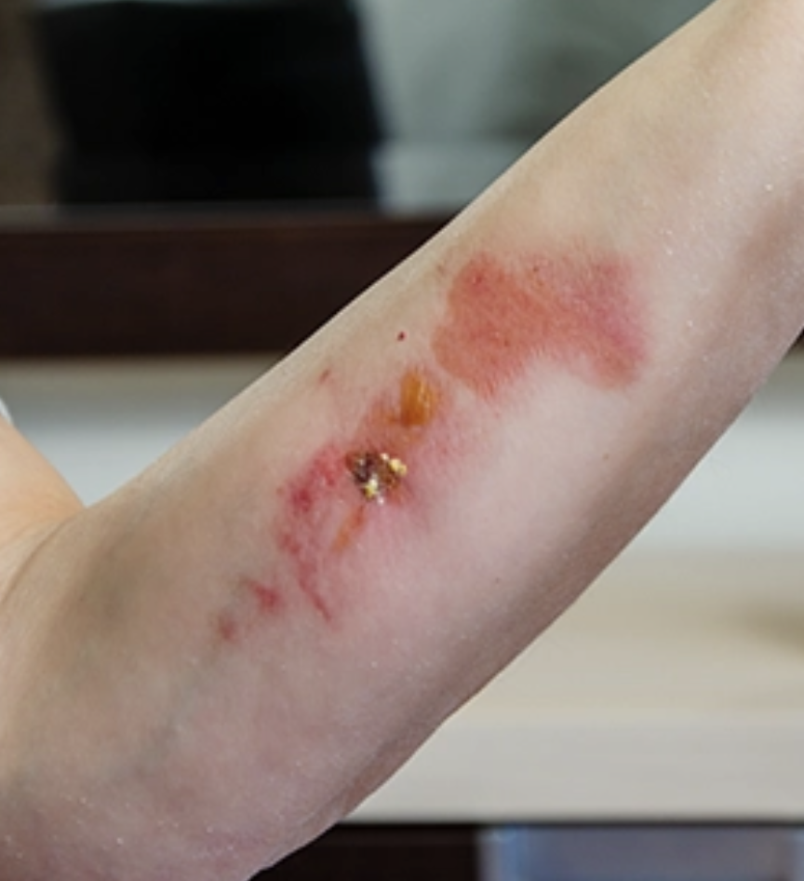
1.8 Accident Management (Burns)
SK-DIV-PPT-005
TYPES OF BURNS (cont.)
RADIATION BURNS
Sunburn and flash burns where patient or clothing did not catch fire
Treatment- remove patient from exposure and cool with cold water for 10 minutes
Give patient frequent sips of water
If mild, use after sun/ calamine lotion.
CHEMICAL BURNS
Acids/alkalis/petrol- severity depends on concentration of agent, time of contact and quantity. Irrigate with water. Get product info from MSDS
Hydrofluoric acid- strongest inorganic acid used for industrial purposes. Deeply penetrating i.e, delayed injury. Decontaminate and neutralize with calcium gluconate
Cement burns- alkaline burns, non painful initially, irrigate and seek medical advice

Slide 9
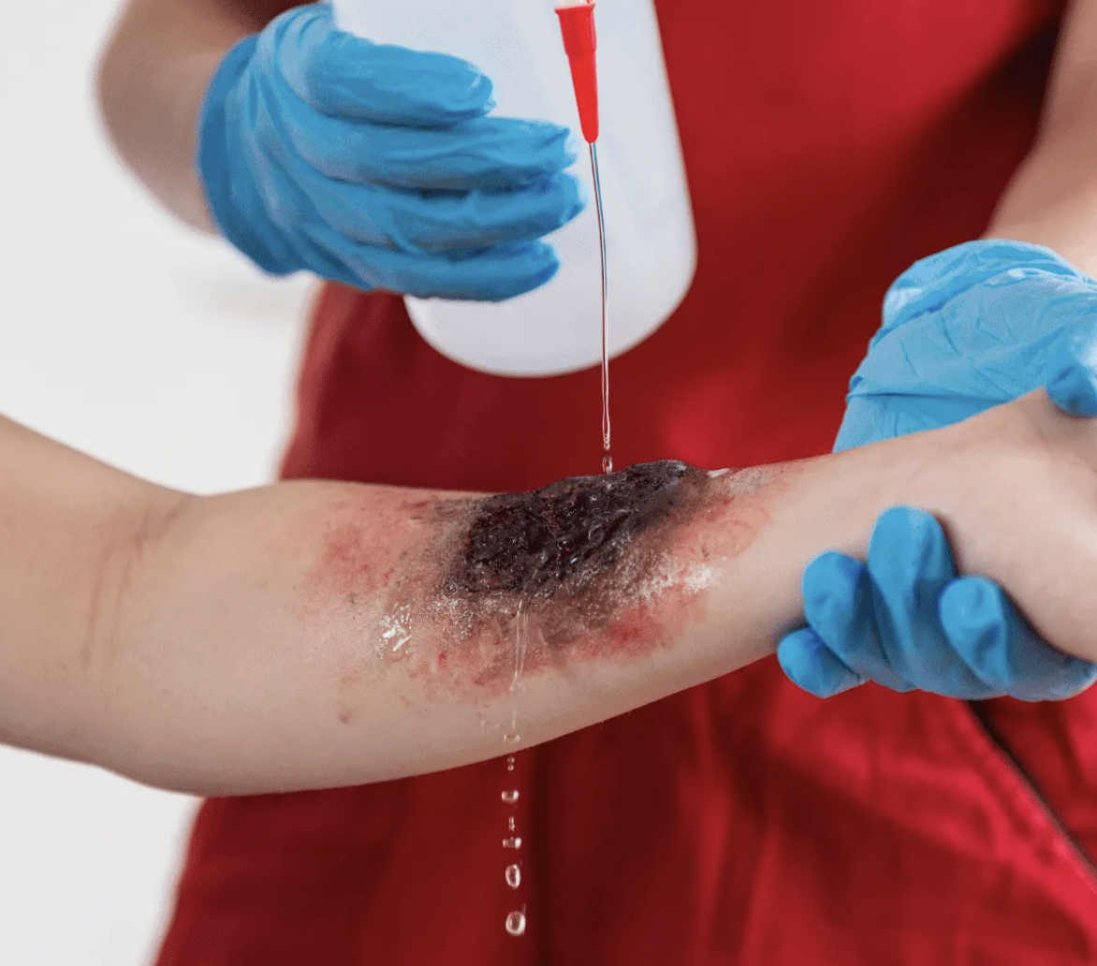
1.8 Accident Management (Burns)
SK-DIV-PPT-005
TYPES OF BURNS (cont.)
ELECTRICAL BURNS
Electrical burns occur when electrical current passes through the body, causing tissue damage. They can affect the skin and deeper tissues, including muscles, nerves, and internal organs. The severity of these burns depends on the type, duration and intensity of electrical exposure.
Low-voltage burns(<1000volts)-Typically localized to the point of contact. May cause superficial or partial-thickness burns
High-Voltage Burns(>1000volts)- Often result in deep tissue damage and can involve significant internal injuries.
Flash Burns- Caused by an electrical arc; these do not involve direct contact with electricity but can lead to thermal burns.
True Electrical Burns- Occur when the body becomes part of the electrical circuit, with entry and exit wounds
Lightning Injuries- results from high-voltage discharge in a short duration; they may cause superficial burns, neurological effects, or cardiac arrest.

Slide 10
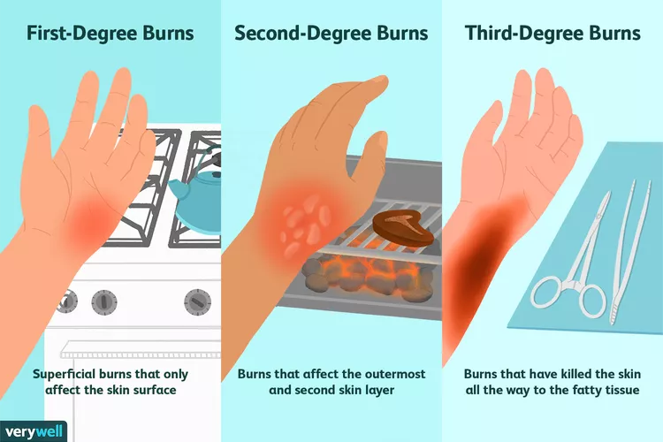
1.8 Accident Management (Burns)
SK-DIV-PPT-005
SEVERITY OF BURNS
Size:
Larger is more severe. % of body surface (approx size of patients hand is 1%)
Cause:
Determines severity, i.e electrical with deep internal burns. Various chemicals
Age:
Babies/children burn at lower temperatures. Elderly take longer to heal, at a higher risk of infection
Location:
Burns to airway, face very severe
Depth:
Deeper burns are more severe

Slide 11
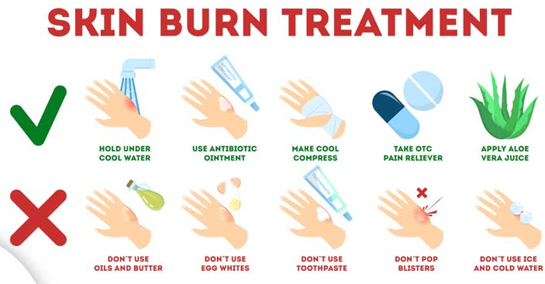
1.8 Accident Management (Burns)
SK-DIV-PPT-005
TREATMENT OF BURNS
Check dangers for self, scene and casualty
Primary survey especially airway and breathing
Cool with cold running water for 10 minutes
Eyes- irrigate with copious amounts of water
Remove jewelry (odema) and unstuck clothing
Dress with sterile non-adherent dressing (cling film)
Analgesia
IV’s
Seek medical assistance

Slide 12
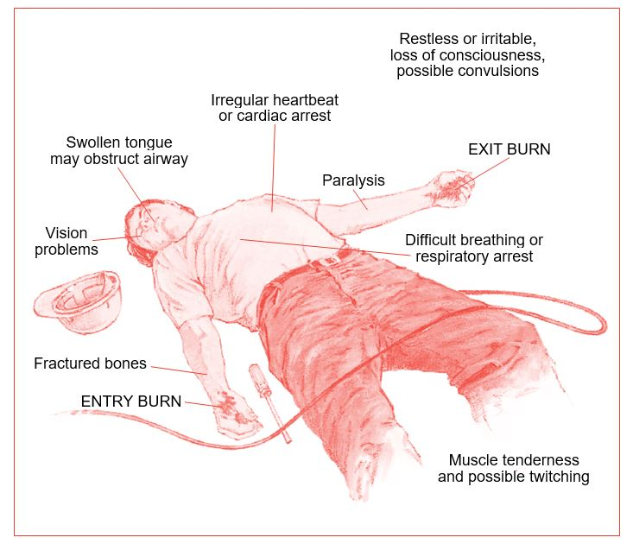
1.9 Accident Management (Electrical Injury)
SK-DIV-PPT-005
ELECTRICAL INJURIES
Occur when an electrical current passes through the body, causing damage to tissues and organs. These injuries can range from minor to life-threatening, depending on factors like voltage, current type, duration of exposure, and the pathway the current takes through the body.
Clinical Features
Burns: can occur as per 1.8.
Cardiac Effects: arrhythmias, cardiac arrest (commonly ventricular fibrillation), or asystole.
Neurological Effects: Seizures, confusion, amnesia, nerve damage or paralysis
Musculoskeletal injuries: fractures or dislocations from muscle contractions or falls
Respiratory Arrest: Secondary to electrical interference with brainstem function
Rhabdomyolysis: Muscle breakdown causing kidney damage
Secondary Trauma: Injuries from falls, explosions, or projectiles.

Slide 13
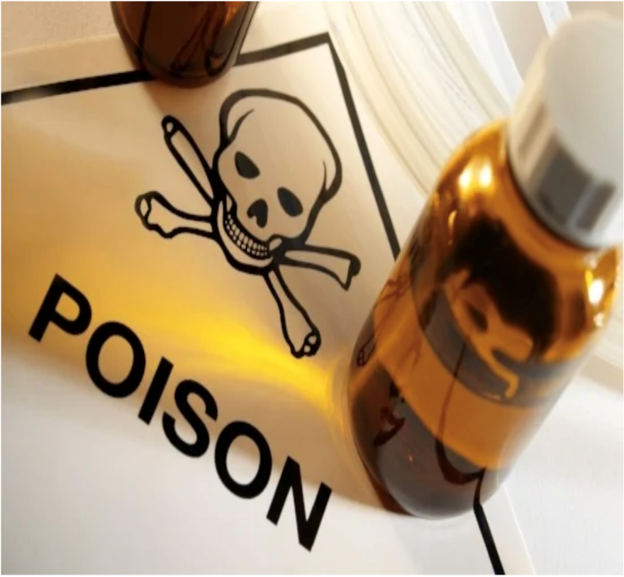
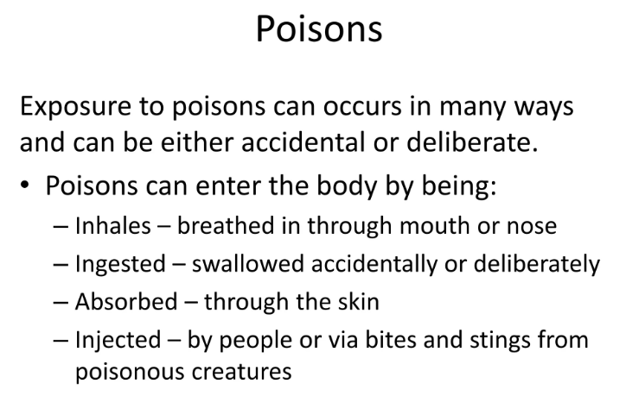
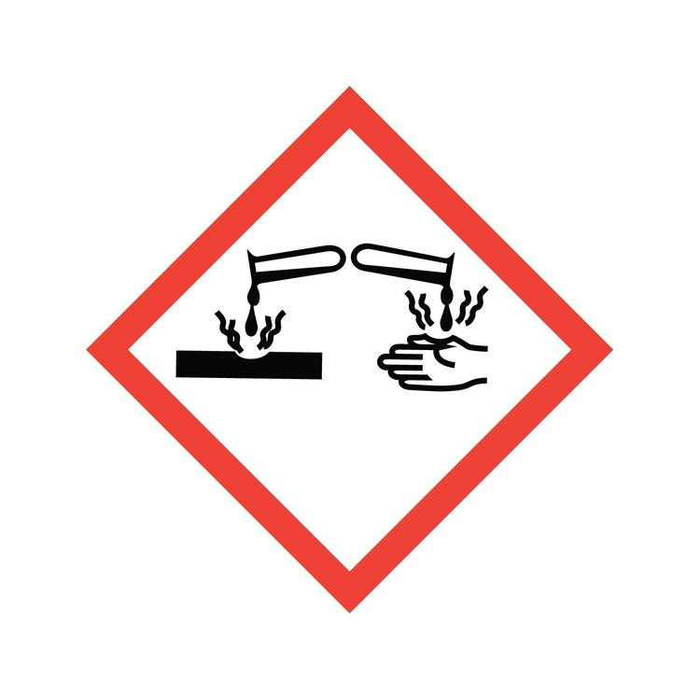
1.10 Accident Management (Poison)
SK-DIV-PPT-005
POISON
Can be
Inhaled
Absorbed
Ingested
Injected
Can be either
Corrosive (i.e, acids/bleach/petrol/turps)
Non –Corrosive (i.e, tablets/drugs/plants)

Slide 14
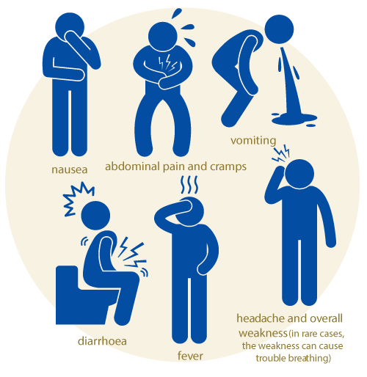
1.10 Accident Management (Poison)
SK-DIV-PPT-005
SIGNS AND SYMPTOMS POISONING
Drowsiness/confusion
Abdominal cramps
Nausea and vomiting
Fitting/unconsciousness
difficulty breathing/ talking due to swelling
Headache
Cyanosis
Blurred vision
Odour on breath
Smell of fumes

Slide 15
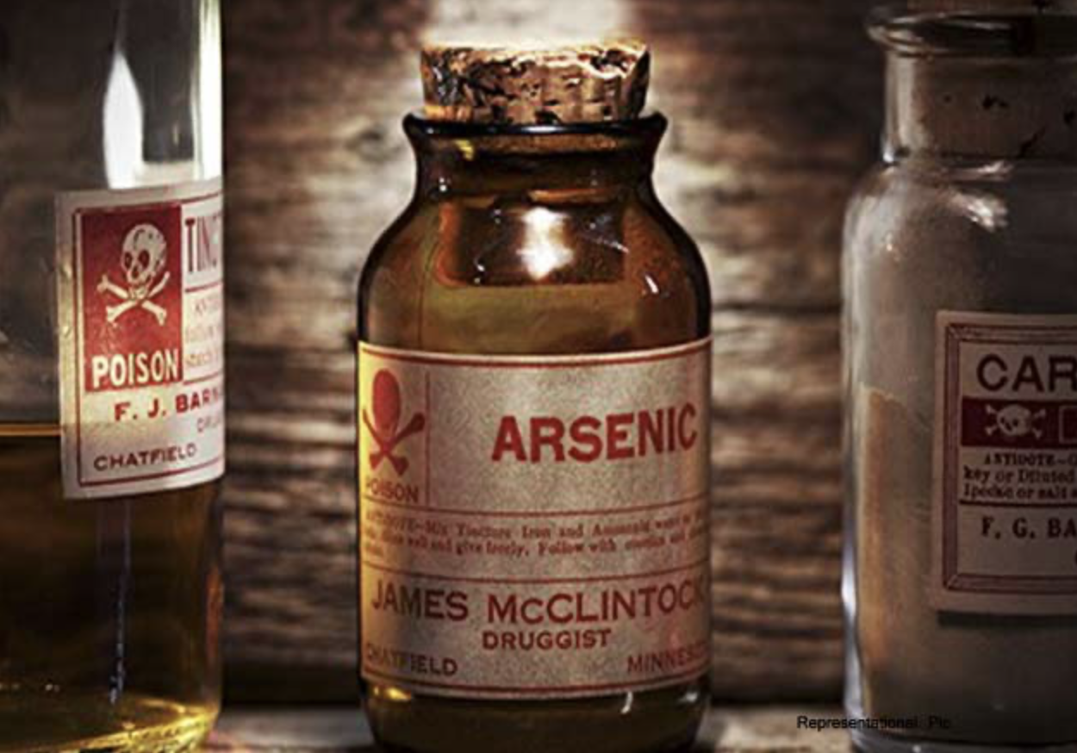
1.10 Accident Management (Poison)
SK-DIV-PPT-005
TREATMENT FOR POISONING
Corrosive
Safety of self/scene/ casualty (ABC)
Skin/eyes- wash substance/ clothes
Oxygen
Nil By Mouth
Do not induce vomiting(retain a sample)
Get medical help/ monitor vital signs
Non-Corrosive
Contact poisons line- treat if instructed
Continue to monitor ABC and gather information

